Slide 1
Sales prediction for Alimentary Industry
Machine learning

Slide 2
Linear Regression
Having analyzed and pre processed the data, the following results are given:
R2:
Train R2: 0.5648
Test R2: 0.5585
Root of the mean squared error:
RMSE Train: 1127.77
RMSE Test: 1127.25
This R2 values are low in a scale of 0 to 1, the show a somehow weak capacity to predict effectively a value given the input.
The RMSE indicates a relatively low value since the range of the Sales goes from 29 to 13000, less than a 10% of error
Both values R2 and RMSE are balanced between Train and Test sets

Slide 3
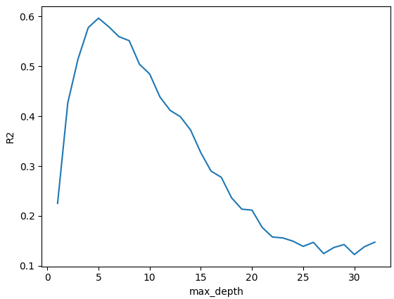
Regression Tree
Having analyzed, pre processed the data and chosen a the optimal depth of 5 levels, the following results are given:
R2:
Train R2: 0.605
Test R2: 0.5968
Root of the mean squared error:
RMSE Train: 0.67
RMSE Test: 1566.62

Slide 4
Regression Tree
This R2 values are low in a scale of 0 to 1, the show a somehow weak capacity to predict effectively a value given the input.
The RMSE indicates a relatively low value since the range of the Sales goes from 29 to 13000, slightly more than a 10% of error
Both values R2 is balanced between Train and Test sets, but RMSE shows signs of overfitting.

Slide 5
Decision
Since the regression tree shows sings of overfitting and there is no way to improve the current data source, I would choose the Linear regression method to predict sales for this alimentary industry.

